Slide 1

Cheminformatic Toolkits
A MetaMolES excavation of various python-compatible resources
ELLie James, ICE Kiattisewee, Phil Leung, Stephen Blaskowski, Yeon Mi Hwang

Slide 2
Cheminformatic Toolkits Overview
Useful for software engineering efforts focused on molecular problems.
Typically exist as a software development kit (SDK)…
…designed to be embedded in and interface with a larger application using APIs
Handle complex chemical structures, transformations, relationships
Information resolution at the single atom level in a variety of formats

Slide 3
Necessary functionalities
Python compatibility
Interconvert between data types
Molecular structure logic (sets, subsets, equivalence, commonalities)
Stepwise bidirectional reactions (construction and deconstruction)
Interact with large datasets from databases
Notes:
Read and save structures in various chemistry file formats.
Determine if one structure is a substructure of another (substructure matching).
Determine if two structures are equal (exact matching).
Disassemble molecules, splitting into fragments.
Assemble molecules from elements or submolecules.
Apply reactions on input reactant structures, resulting in output of reaction product structures.

Slide 4
Useful Functionalities
Good documentation
Tanimoto Similarity Index handling
Ipython notebook compatibility
A history of being used successfully in previous efforts
Molecular fingerprinting
Notes:
Fingerprints are bit-vectors where individual bits correspond to the presence or absence of structural features. The most important use of fingerprints is in indexing of chemistry databases. This is necessary for ML purposes.

Slide 5

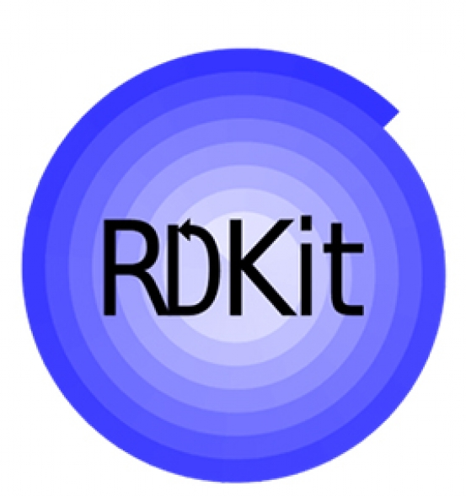
RDKit Intro
Open source cheminformatic and ML SDK
C++ core with Python 3 wrapper allowing interoperability
6 month continuous rerelease cycle
Active github: (https://github.com/rdkit)
Notes:
Python (2.x and 3.x) wrappers generated using Boost.Python
Business-friendly BSD license
Github has almost 6000 commits, and nearly 70 contributors.

Slide 6
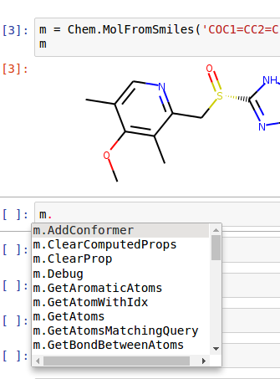
RDKit Functionality
Python API, extensive examples and jupyter-based tutorials
Wide range of formats including SMILES.
Atom-Atom matching, substructure queries, exact equivalence matching
Molecular clustering
Chemical reaction handling including chirality

Slide 7
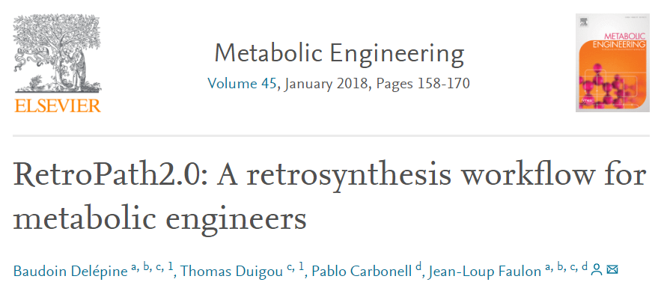
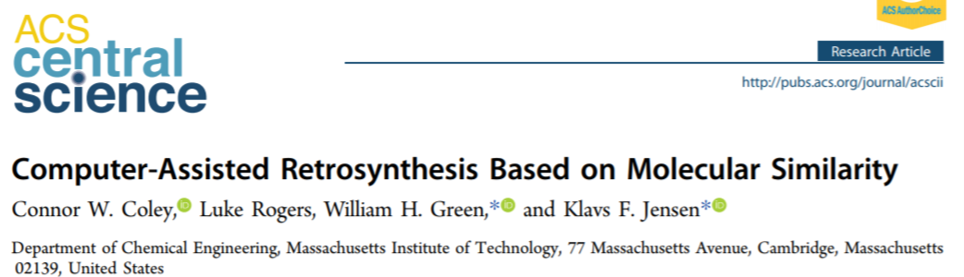
RDKit Functionality
Maximum common substructure finding for promiscuous substrates
Notes:
Maximal common substructure identification of substructures common to structures in a set.

Slide 8
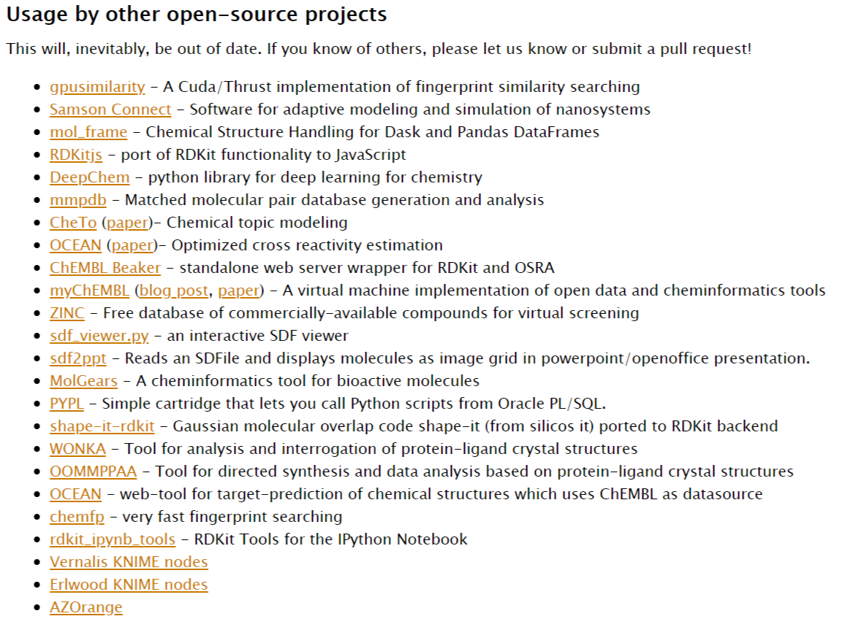
RDKit Usage
Notes:
Over 1790 results since 2006 on google scholar.
List speaks for itself.

Slide 9
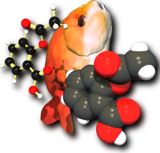
Alternatives: OpenBabel
Ready-to-use programs for interconverting, searching, modifying, and analyzing chemical files
C++ based SDK with a Python wrapper
Primarily designed to excel at interconverting between the many different languages and formats in which chemical and molecular data is stored

Slide 10

Alternatives: 3D-e-Chem
Seek to improve the integration of ligand and protein data
Intended to be used for structure-based prediction of protein-ligand interactions
Generally narrower use cases and flexibility
7 publications listed, all from labs related to development
Much less active on github (https://github.com/3D-e-Chem)
Notes:
We think we are going to choose RDKit, largely due to the plethora of successful projects and publications that have utilized it. RDKit seems to be the most well-documented and has the most tutorials.

